Slide 1

A Minor Project on
ONLINE FOOD ORDERING
( FOODHUT)
Gautam Buddha University Greater Noida, Gautam Buddha Nagar, Uttar Pradesh
School Of Information and Communication Technology
Master Of Computer Application Artificial Intelligence (MCA-AI)
Faculty Name:
Mr. Kamala Kant Yadav
Assistant Professor
Presented By:
Nishita Saini - 235/PCA/017
Prachi – 235/PCA/019
Shubham Kumar Yadav – 235/PCA/025

Slide 2
Contents
INTRODUCTION
OBJECTIVE
SCOPE
ADVANTAGES
CHALLENGES
DEVELOPMENT TOOL
SYSTEM ARCHITECTURE
ER DIAGRAM
DATA FLOW DIAGRAM (DFD)
SCREENSHOT
CONCLUSION
References

Slide 3
Introduction
In today’s fast-paced world, the demand for convenient dining solutions has surged, making online food ordering an integral part of modern consumer behaviour. This project aims to develop an online food ordering platform that simplifies the process of ordering meals from various restaurants, enhancing customer experience while providing efficient service to food vendors.
The proposed system will offer a user-friendly interface that allows customers to browse a wide range of restaurants, view menus, customize their orders, and make secure payments. With real-time tracking, users can monitor their order status from preparation to delivery.

Slide 4
Objective
The online food ordering system is to create a user-friendly platform that allows customers to conveniently browse, select, and order food from their favourite restaurants. The system aims to streamline the process of food ordering by providing the following features:
User-Friendly Interface: Create an intuitive platform for easy browsing, order customization, and seamless purchases.
Real-Time Order Tracking: Provide users with updates on order status from preparation to delivery for enhanced transparency.
Restaurant Management System: Develop an interface for restaurant managers to efficiently manage orders, menus, inventory, and sales data.
User Account Features: Allow users to create and manage accounts with order history, saved payment methods, and personalized recommendations.
Mobile Compatibility: Ensure full responsiveness and functionality on mobile devices for users who prefer ordering via smartphones and tablets.
Data Security and Privacy: Implement robust security measures to protect user data and comply with regulations.
Feedback System: Establish a mechanism for customers to provide feedback and their experiences, aiding service improvement.

Slide 5
Scope
The online food ordering system project aims to create a platform for users to order food from various restaurants via a web-based and mobile application. It will cater to both customers and restaurant managers with distinct features for each group.
Customer Interaction: Users can browse menus, customize orders, and place them online securely with multiple payment options. Real-time order tracking, account creation, order history, and personalized promotions will enhance the experience.
Restaurant Management: Restaurants will have an interface to manage orders, update menus, handle inventory, and apply discounts. They can track order statuses, adjust delivery times, and access sales reports for better performance. The system will support multiple branches.
Technical Features: The project includes mobile apps for Android and iOS and a web platform accessible via browsers. It will integrate secure payment gateways and be designed to scale with a growing user base. Third-party delivery services will be used for fulfilment.

Slide 6
Advantages of online food order
1. Enhanced Customer Convenience:
Online Ordering: Customers can place orders from the comfort of their homes, reducing wait times and improving overall satisfaction.
2. Increased Reach and Accessibility:
24/7 Availability: The website is accessible at any time, allowing customers to browse the menu and place orders outside of regular business hours.
Mobile-Friendly Design: Ensures that the website is easily accessible on smartphones and tablets, catering to a wider audience.
3. Improved Operational Efficiency:
Order Management: Streamlines the order-taking process, reducing errors and improving kitchen efficiency.
Customer Data: Collects valuable customer data that can be used for targeted marketing and improving service offerings.
4. Cost-Effective Solution:
Reduced Overhead: Minimizes the need for additional staff to take orders over the phone.
Marketing Savings: Digital marketing through the website can be more cost-effective than traditional methods.
5. Customer Engagement and Loyalty:
Feedback System: Provides a platform for customers to leave reviews and feedback, helping to build trust and loyalty.
Loyalty Programs: Integrate loyalty programs to reward repeat customers, encouraging them to return.
6. Scalability:
Easily Updatable: The website can be easily updated with new menu items, promotions, and features without significant additional costs.
Expansion Ready: Can support the addition of new locations or services as the business

Slide 7
1. Scope Creep
Challenge: Occurs when new features are added without adjusting time, budget, or resources.
Solution: Clearly define the project scope at the beginning and regularly manage any changes.
2. Technical Difficulties
Challenge: Bugs and integration problems may arise during development.
Solution: Conduct thorough testing and maintain a solid troubleshooting plan.
3. Resource Management
Challenge: Ensuring availability of skilled developers and adequate budgets.
Solution: Plan resource allocation carefully and monitor usage throughout the project.
4. Security Concerns
Challenge: Protecting user data from cyber threats.
Solution: Implement robust security measures, such as SSL certificates and data encryption.
5. Integration with Third-Party Services
Challenge: Compatibility issues when integrating with payment gateways and other services.
Solution: Choose well-documented services and thoroughly test integrations.
6. Maintaining Performance
Challenge: Ensuring good performance during high traffic.
Solution: Optimize code and use performance monitoring tools to identify bottlenecks.
Challenges

Slide 8
Development Tool (Software Requirement and Hardware Requirement)
Software Requirement
Hardware Requirement
S.NO | Software | Use
1. | OPERATING SYSTEM | Windows 11.
2. | FRONT-END | HTML, CSS, JAVASCRIPT and BOOTSTRAP.
3. | BACK-END | PHP.
4. | DATABASE | MYSQL.
5. | HELP TOOL | XAMPP and VISUAL STUDIO.
S.NO | Hardware | Use
1. | PROCESSOR | AMD RYZEN 5.
2. | RAM | 4GB
3. | DISK | 255GB SSD and 1TB HDD

Slide 9
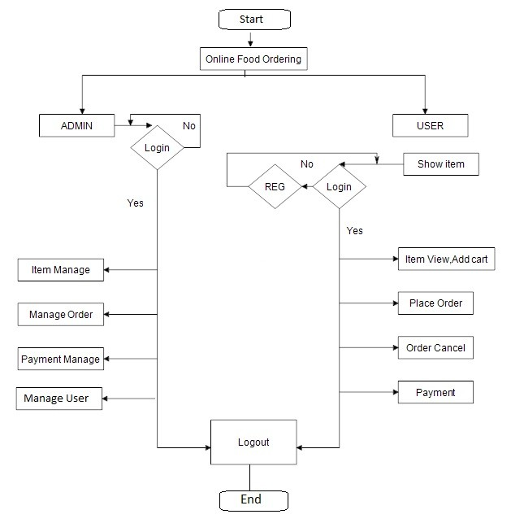
System Architecture (Work Flow)

Slide 10
DFD (Data Flow Diagram)
DFD is the abbreviation for Data Flow Diagram. The flow of data in a system or process is represented by a Data Flow Diagram (DFD). It also gives insight into the inputs and outputs of each entity and the process itself. Data Flow Diagram (DFD) does not have a control flow and no loops or decision rules are present. Specific operations, depending on the type of data, can be explained by a flowchart.
0-level DFD
It is also known as a context diagram. It’s designed to be an abstraction view, showing the system as a single process with its relationship to external entities. It represents the entire system as a single bubble with input and output data indicated by incoming/outgoing arrows.
1-Level DFD
This level provides a more detailed view of the system by breaking down the major processes identified in the level 0 DFD into sub-processes. Each sub-process is depicted as a separate process on the level 1 DFD. The data flows and data stores associated with each sub-process are also shown. In 1-level DFD, the context diagram is decomposed into multiple bubbles/processes.

Slide 11
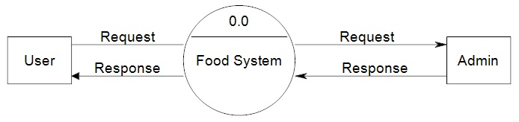
ZERO LEVEL (DFD)

Slide 12
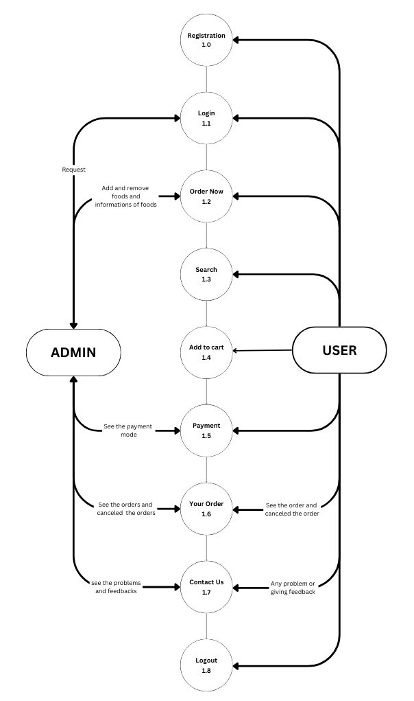
FIRST LEVEL (DFD)

Slide 13
ER (ENTITY RELATIONSHIP )
The Entity Relationship Model is a model for identifying entities to be represented in the database and representation of how those entities are related. The ER data model specifies enterprise schema that represents the overall logical structure of a database graphically.
Peter Chen developed the ER diagram in 1976. The ER model was created to provide a simple and understandable model for representing the structure and logic of databases. It has since evolved into variations such as the Enhanced ER Model and the Object Relationship Model.
The Entity Relationship Diagram explains the relationship among the entities present in the database. ER models are used to model real-world objects like a person, a car, or a company and the relation between these real-world objects. In short, the ER Diagram is the structural format of the database. In this article we will see entity relationship model in detail.

Slide 14
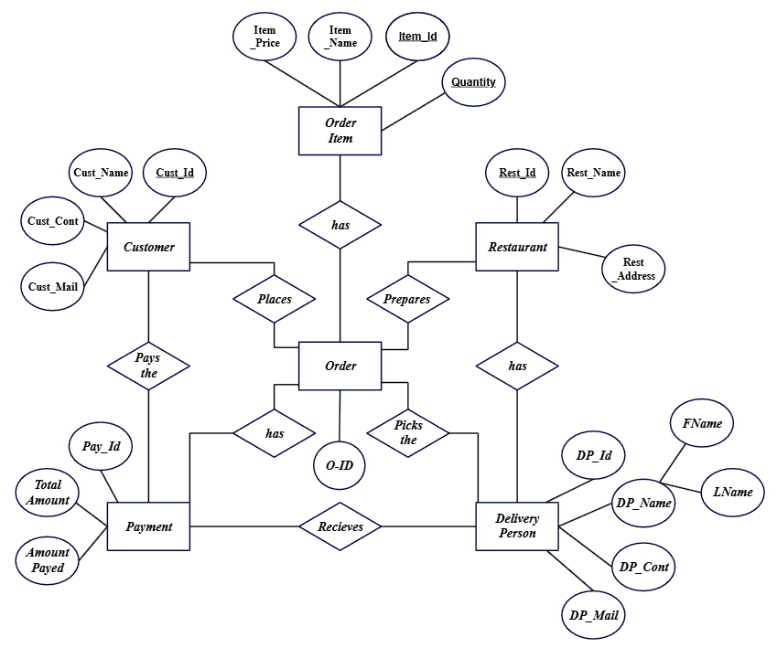
ER (ENTITY RELATIONSHIP DIAGRAM)

Slide 15
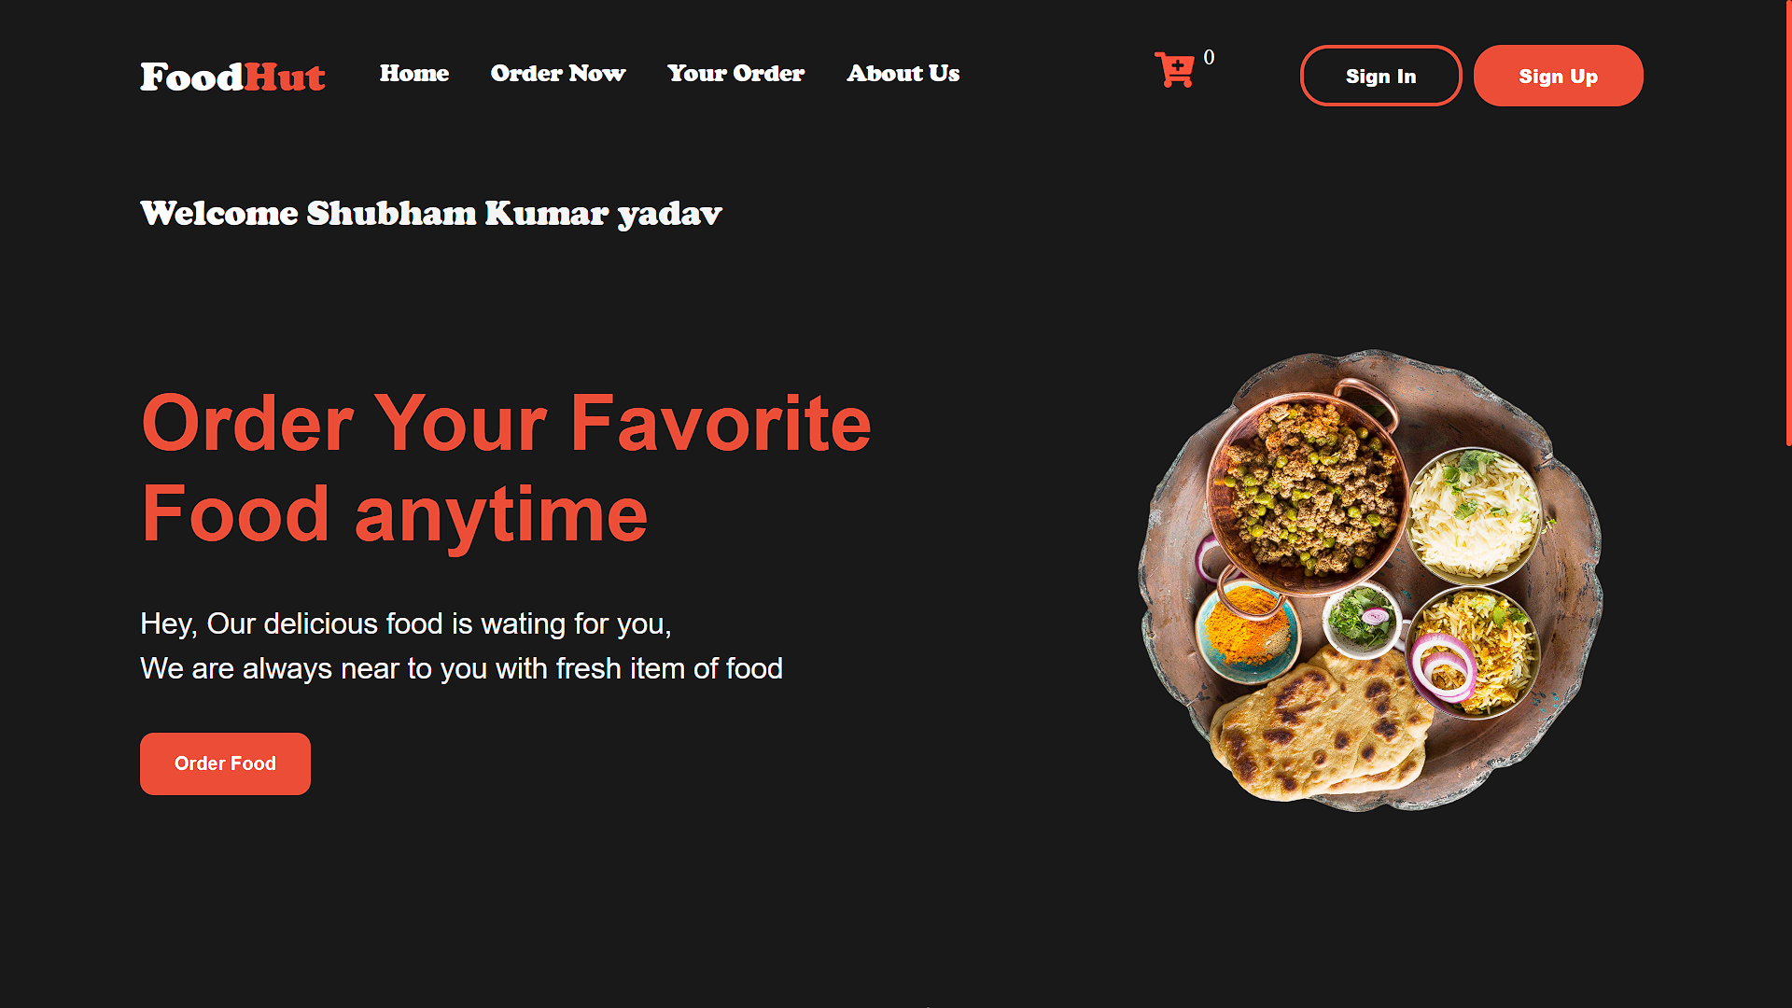
SCREENSHOT
Home Page

Slide 16
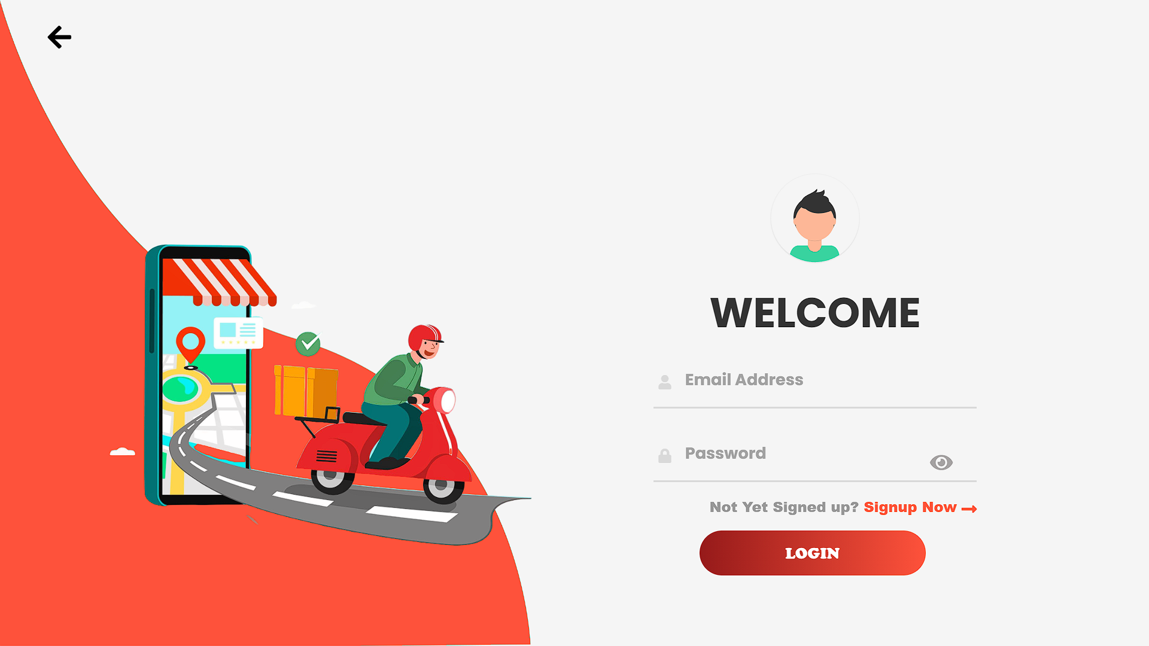
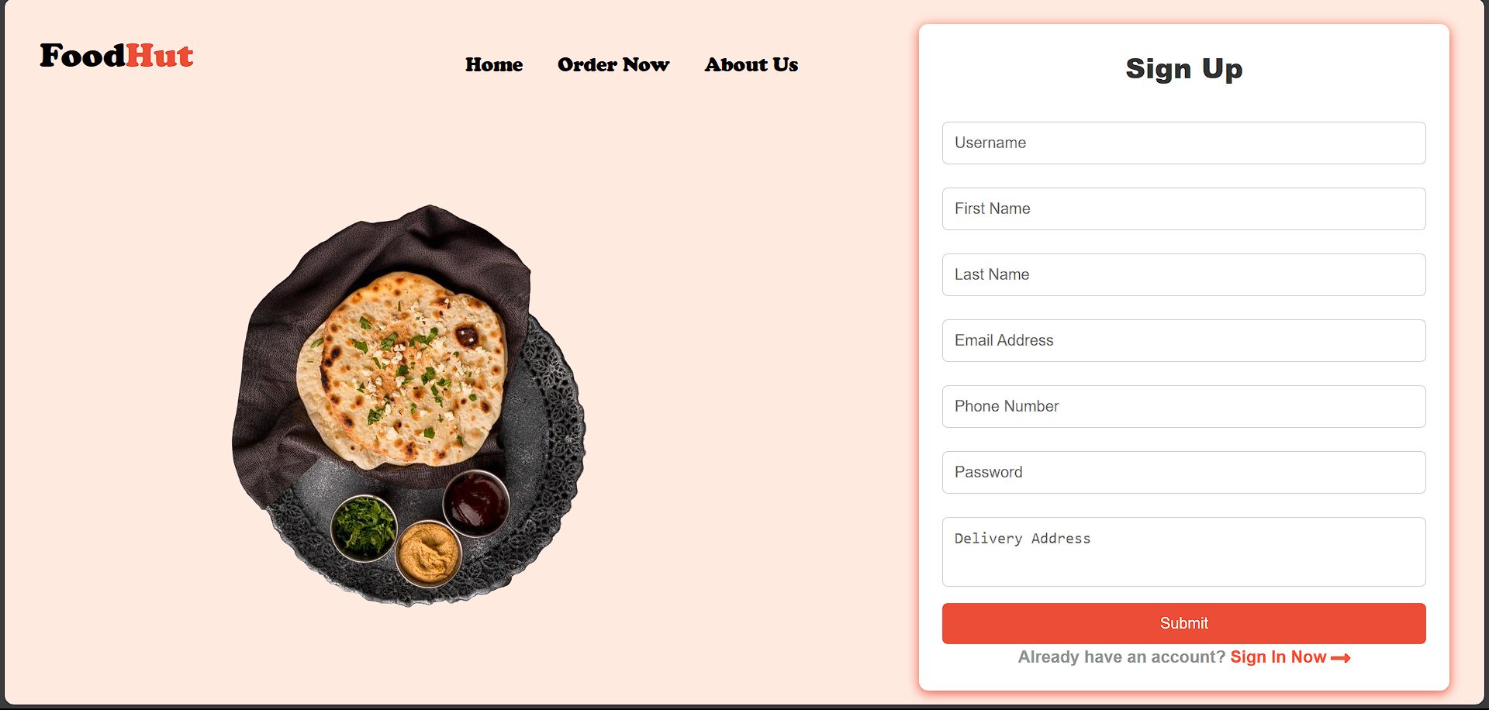
Sign In
Sign UP

Slide 17
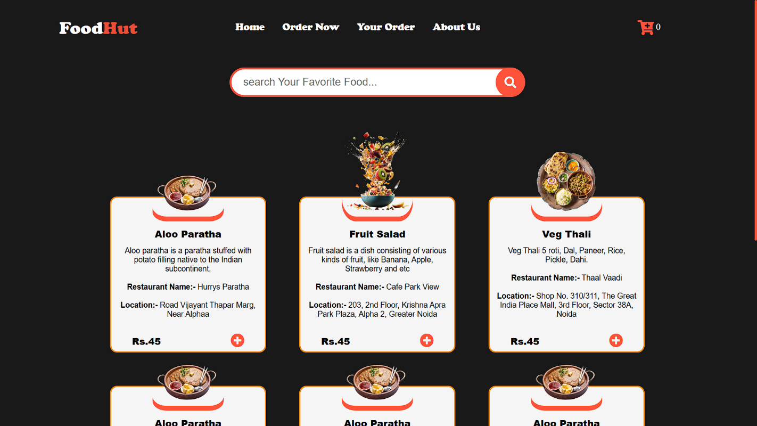
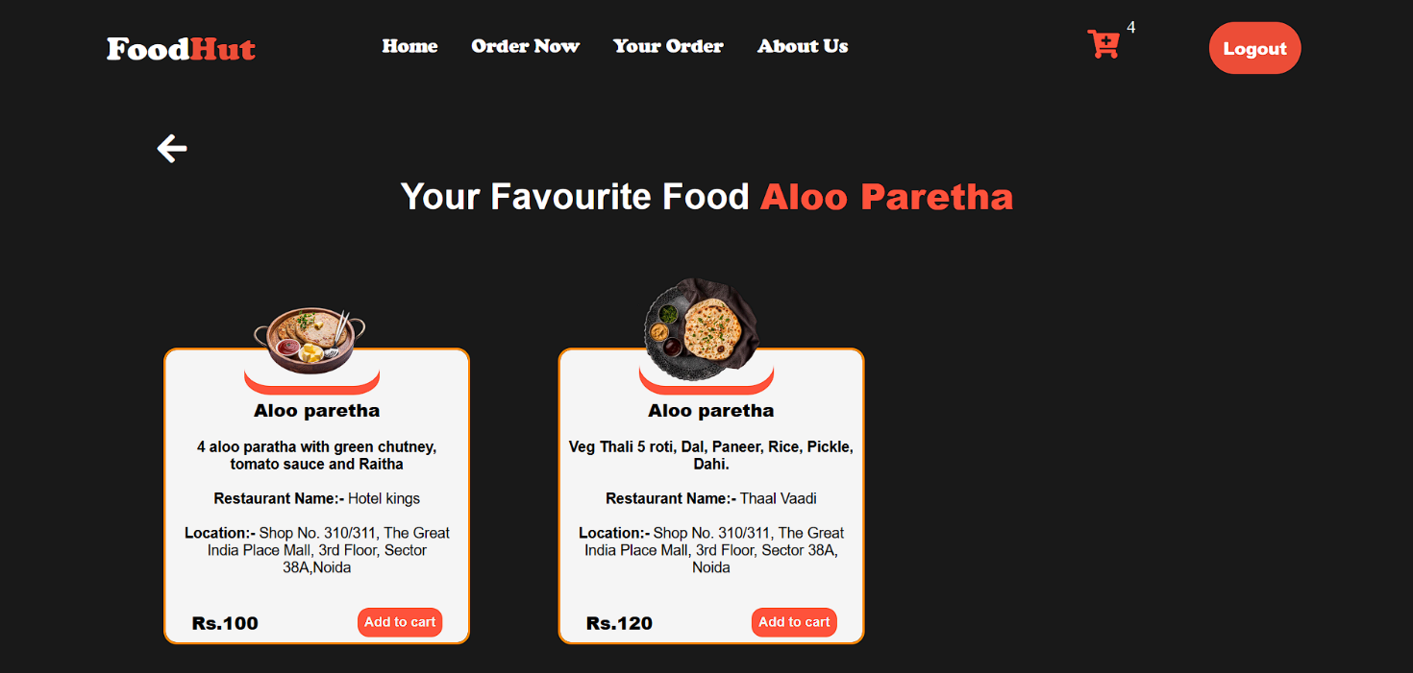
Order now page
SEARCHING PAGE

Slide 18
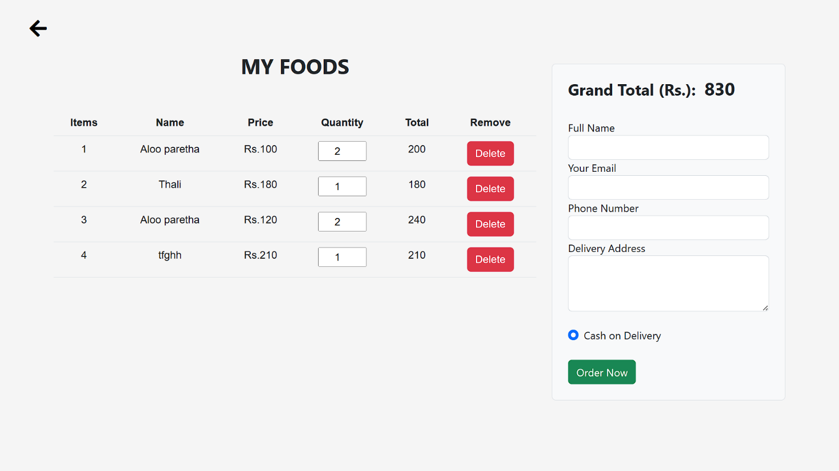
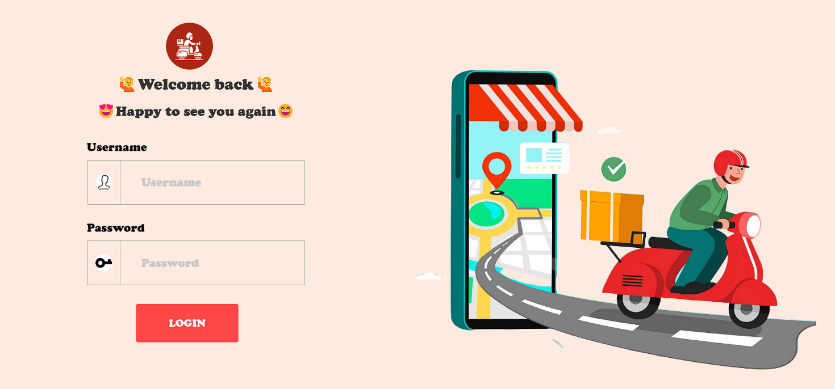
ADD TO CART AND PAYMENT MODE
ADMIN LOGIN PAGE

Slide 19
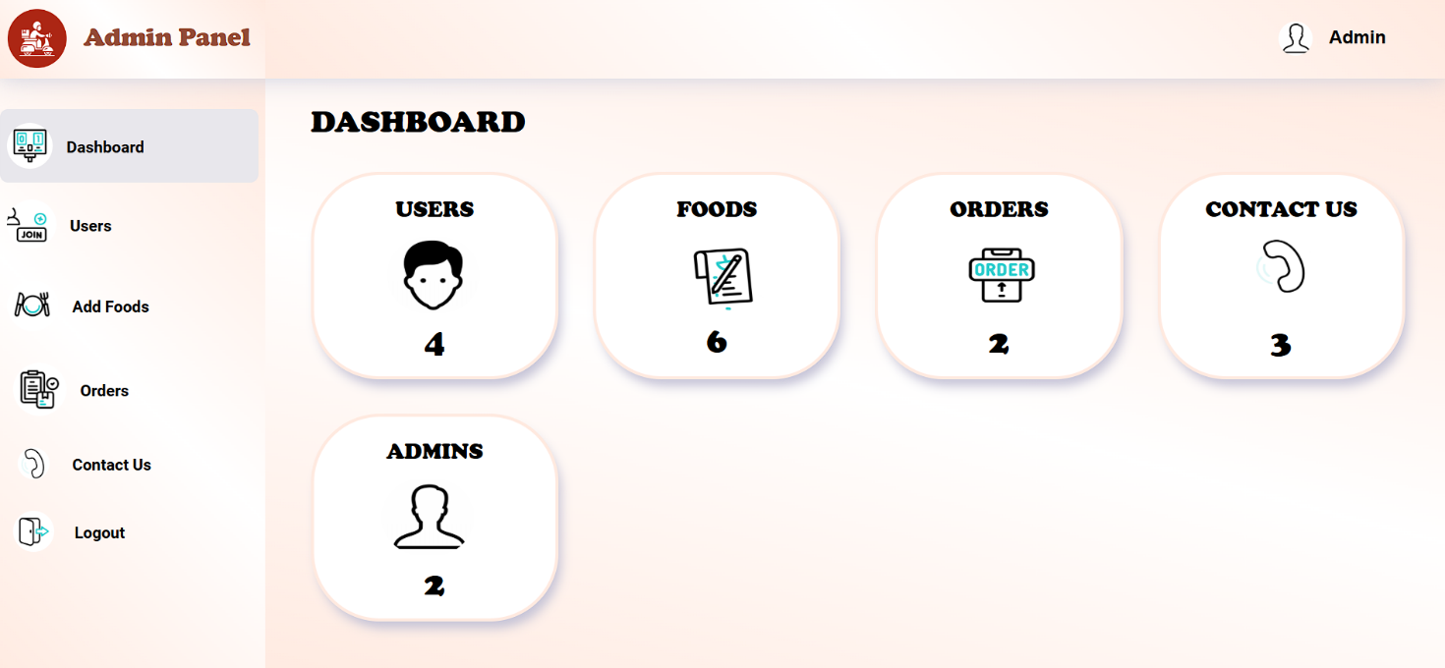
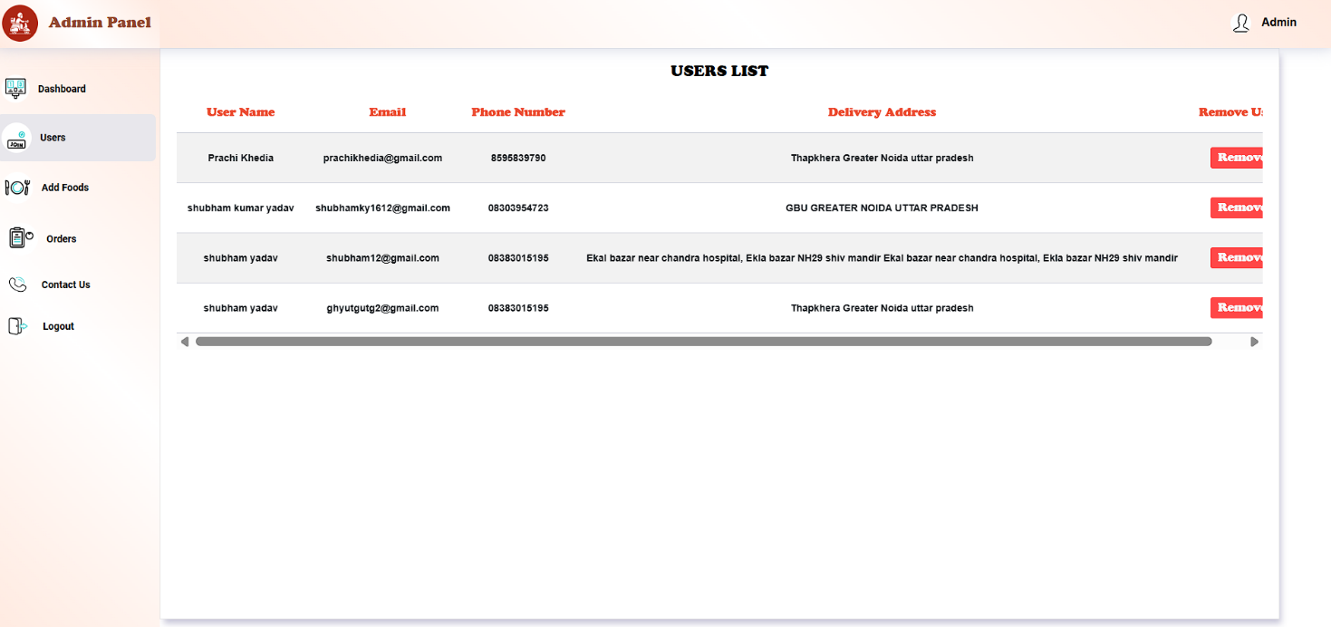
DASHBOARD
USER LIST PAGE

Slide 20
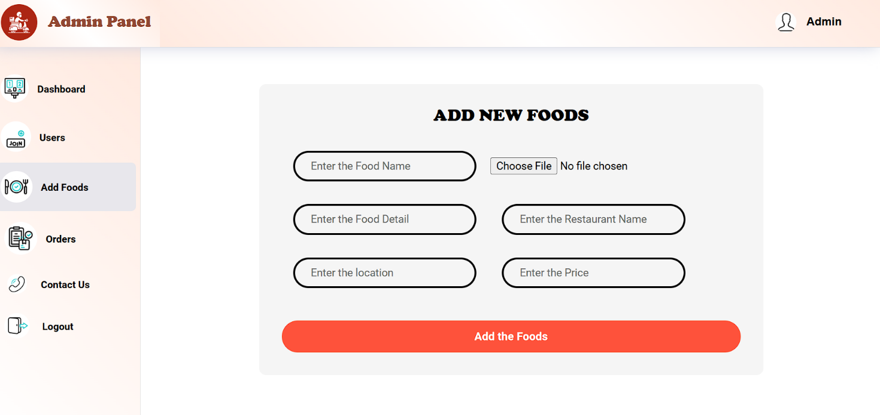
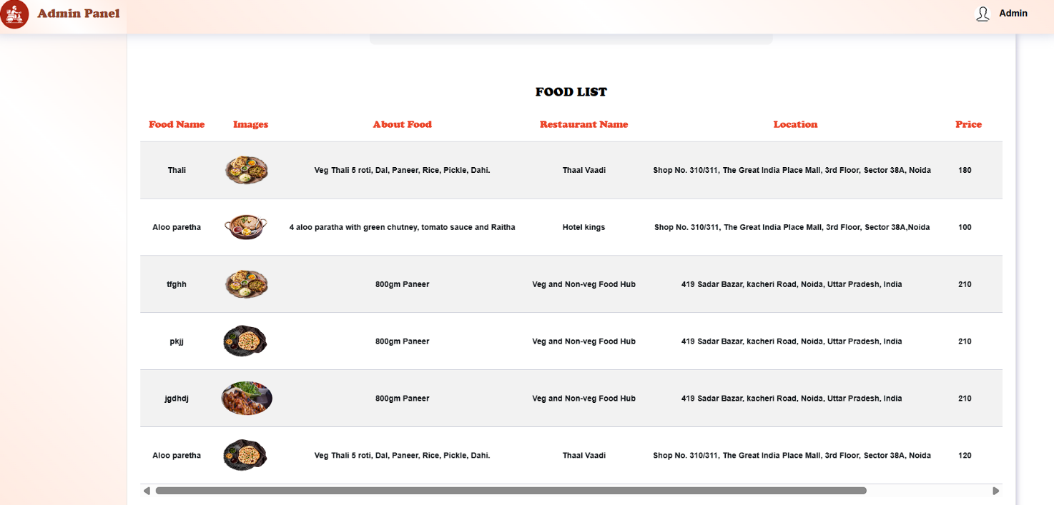
ADD FOODS PAGE
FOOD LIST PAGE

Slide 21
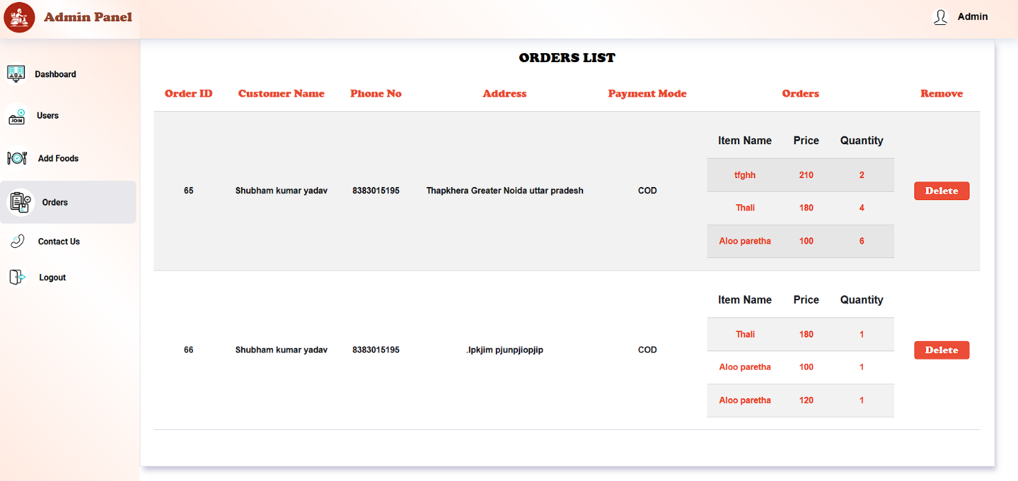
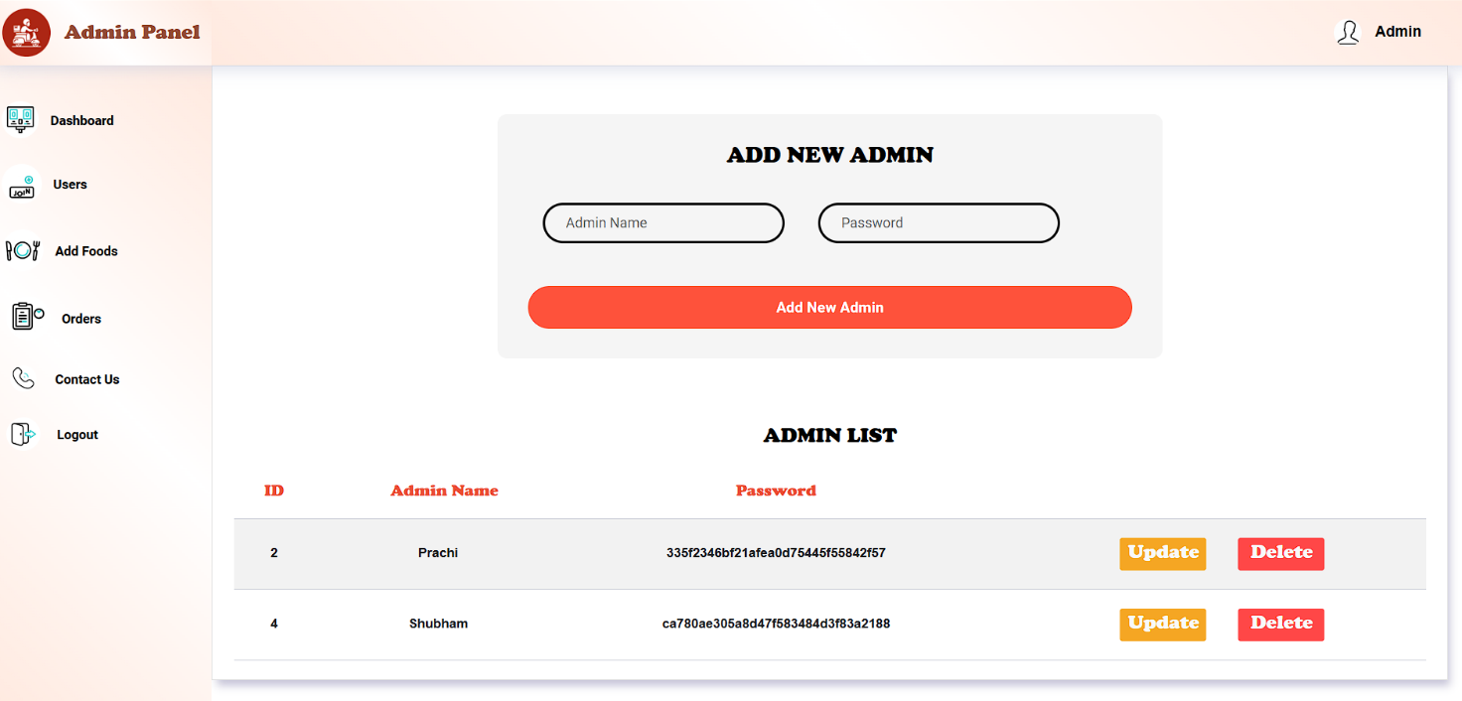
OrderS LIST page
ADMIN CHANGE PAGE

Slide 22
Conclusion
online food ordering serves as a vital platform that bridges the gap between consumers and restaurants, making it easier for users to explore diverse culinary options from the comfort of their homes. By leveraging user-friendly interfaces, secure payment gateways, and efficient order t, such platforms enhance the overall dining experience, providing convenience and accessibility.
The success of an online food ordering relies not only on technology but also on building strong partnerships with local restaurants and ensuring the highest standards of food quality and delivery services. As customer preferences evolve and the demand for food delivery continues to rise, investing in features like personalized recommendations, real-time updates, and customer support becomes crucial for retaining and expanding the user base.
Ultimately, a well-designed online food ordering can significantly enhance customer satisfaction while driving growth and profitability for restaurants, positioning itself as an indispensable tool in today’s fast-placed food industry.
Overall, online food ordering helps connect customers with delicious food in a quick and easy way.

Slide 23
References
https://en.wikipedia.org/wiki/Online_food_ordering
https://en.wikipedia.org/wiki/Food_delivery
https://www.zomato.com/
https://www.swiggy.com/
https://www.w3schools.com/php/default.asp
https://www.mysql.com/products/community/

Slide 24
Any Query?
Thank you

